Slide 1


Lavazza Project

Slide 2

Table of Contents
Value Proposition
Project Goal
Research Questions
Method
Experiments
Conclusion
Checkpoint 3

Slide 3
Project Value Proposition
For marketers seeking deeper insights on product launches, our analytics software transforms raw online comments and reviews into actionable metrics.

Slide 4
Project Goal
Developing an application software in order to understand the real impact of a product launch, in terms of consumers sentiment crossing social media comments and third-party reviews.

Slide 5
Research questions
Can Large Language Models be used to extract useful insights from consumers comments and reviews to improve marketing strategies?
In particular:
How effectively can LLMs identify product-relevant comments?
To what extent LLMs are able to extract product aspects from reviews and comments and assign sentiments to them?
How successfully are LLMs able to assign a sentiment to comments and rating stars to reviews?

Slide 6
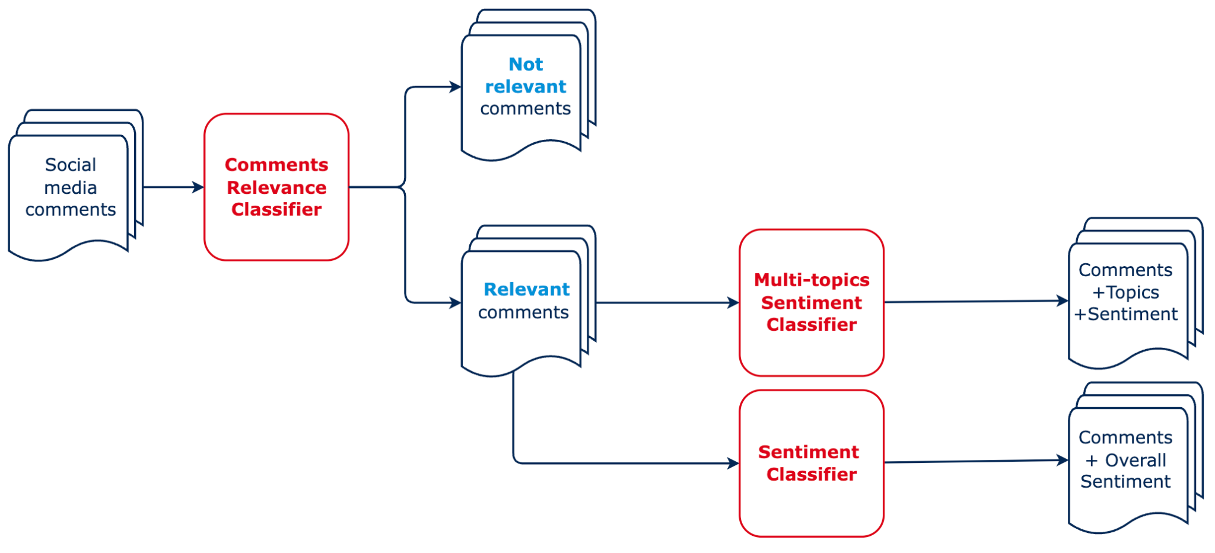
Method - Comments Pipeline

Slide 7
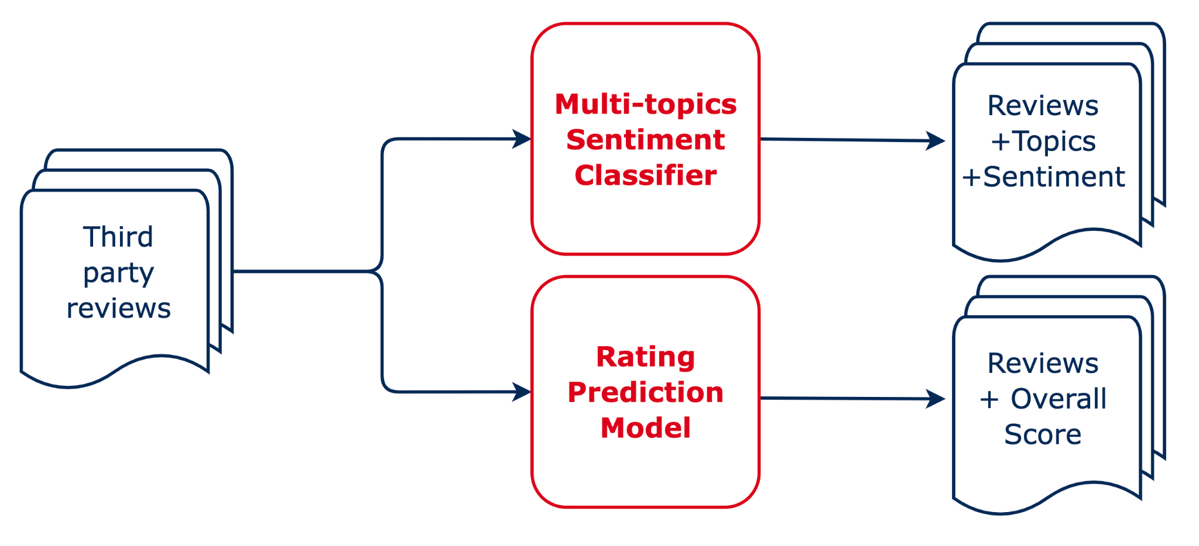
Method - Reviews Pipeline

Slide 8
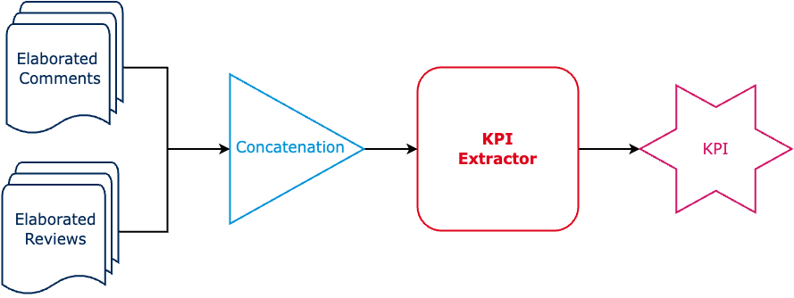
Method - KPI Extraction Pipeline
KPI Extractor: A set of predefined functions designed to draw conclusions or perform analyses on final data.

Slide 9
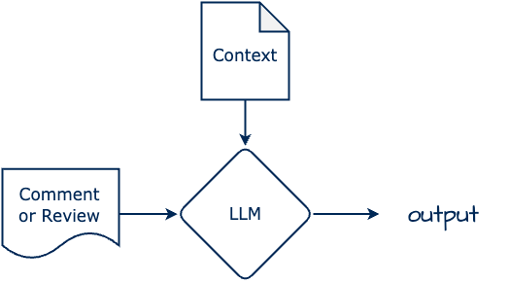
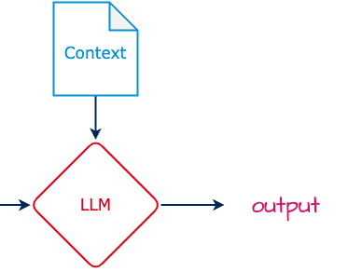
Method - Classification Block
Context: A prompt containing task instructions, either with examples for a few-shot approach or without examples for a zero-shot approach.
Output: Classification labels i.e.
relevance label
topic label and sentiment
overall sentiment or star rating

Slide 10
Method - Models
We have tested various models in order to define which is the best for our goals.
Two different type of models:
General purpose, chat like
Specialized

Slide 11



Method - General Purpose Models
Gemma2: large language model from Google, different versions: 2B, 9B and 27B
Llama3: large language model from Meta, 8B, 70B and 405B
Mistral: large language model from Mistral AI

Slide 12

Method - Specialized Models
DistilBert and Twitter-RoBerta: fine-tuned versions of Bert

Slide 13





Experiments - Data
Data Sources:
Wonderflow
Digiming
YouTube
Instagram
Generative Models
Datasets:
Reviews
Comments
Synthetic Comments

Slide 14
Experiments - Datasets
Reviews:
Records: 2930
Reviews labelled for Sentiment Classification: 96,5% of the reviews have at least one label between positive, negative and neutral topics.
Reviews labelled for Star Rating: 100%
Tiny Eco Reviews: 79
Comments:
Records: 573
Labelled Comments: 0%
Tiny Eco Reviews: 76
Synthetic Comments:
Records: 236
Labelled Comments: 100%

Slide 15

Experiments - Tasks
Relevance classification
Multi-topic sentiment classification
Positive Topics
Negative Topics
Sentiment classification
Positive
Negative
Neutral
Star rating:

Slide 16
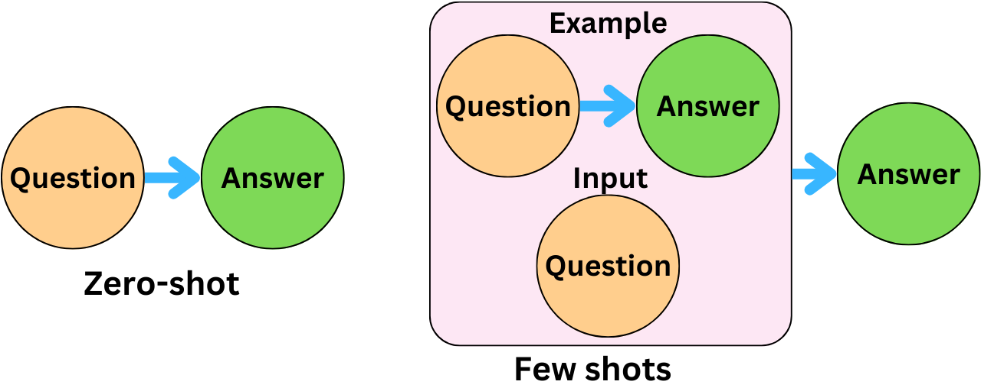
Experiments - Configurations
Run Configuration: Few Shot and Zero Shot prompting
Hardware Configuration: Experiments on a Kaggle notebook, using two NVIDIA Tesla T4 GPUs

Slide 17
Experiments - Relevance Classification
Data: 236 synthetic comments
Batch-size: 15 comments
Model | Accuracy (0-Shot) | Accuracy (Few-Shot)
Gemma-2-9B-it | 79.24% | 80.51%
Llama-3.1-8B-it | 81.78% | 83.9%
Mistral-7b-it-v0.3 | 77.54% | 79.24%

Slide 18
Experiments - Multi-topic Sentiment
Classification
Data: 500 labeled reviews + 236 synthetic comments
Batch-size: 1 comment/review
Model | Accuracy (0-Shot) | Accuracy (Few-Shot)
Gemma-2-9B-it | 96.83% | 99.07%
Llama-3.1-8B-it | 91.53% | 96.19%
Mistral-7b-it-v0.3 | 85.94% | 89.74%

Slide 19
Experiments - Sentiment Classification
Data: 236 synthetic comments
Batch-size: 15 comments
Model | Accuracy (0-Shot) | Accuracy (Few-Shot)
Gemma-2-9B-it | 89.41% | 90.68%
Llama-3.1-8B-it | 85.17% | 83.47%
Mistral-7B-it-v0.3 | 83.47% | 82.63%
RoBerta-base-sentiment | 91.59% | 91.59%

Slide 20
Experiments - Star Rating
Data: 500 labeled reviews
Batch-size: 1 comment/review
Model | Accuracy | Accuracy off by one
Gemma-2-9B-it | 63.85% | 88.46%
Llama-3.1-8B-it | 31.07% | 82.52%
Mistral-7B-it-v0.3 | 64.69% | 93.08%
Distilbert-base-uncased | 69.99% | 95.48%

Slide 21
Experiments - Models Inference Time
The time, in seconds, taken by the model to generate a response.
This time was taken during the multi-topics sentiment classification process.
Model | Time (0-Shot) | Time (Few-Shot)
Gemma-2-9B-it | 7.06s | 9.13s
Llama-3.1-8B-it | 2.93s | 3.51s
Mistral-7b-it-v0.3 | 6.09s | 6.43s
Distilbert-base-uncased | 0.01s | 0.01s

Slide 22
Conclusion
We can conclude by saying that:
LLMs are able to identify relevant product comments, with an accuracy of up to 83.9%.
LLMs are able to extract product aspects from reviews and comments and assign sentiment to them, with an accuracy of up to 99.07%.
LLMs are able to assign sentiment to comments and rating stars to reviews, with an accuracy of up to 90.68% and 93.08% respectively.
In particular, we have found that the model that generally performs best is Gemma 2 with the few shot prompting configuration.

Slide 23
Thank you
Alessio Gioè - Catalano Vincenzo - Tommaso Mazzarini

